Slide 1

A Lightweight CNN Framework for Multi-Class Cassava Leaf Disease Detection
Presented for the fulfillment of Project-I (BCS753) for the Bachelor of Technology degree.
Department of Computer Science and Engineering, Bhagwant Institute of Technology, Muzaffarnagar.

Slide 2
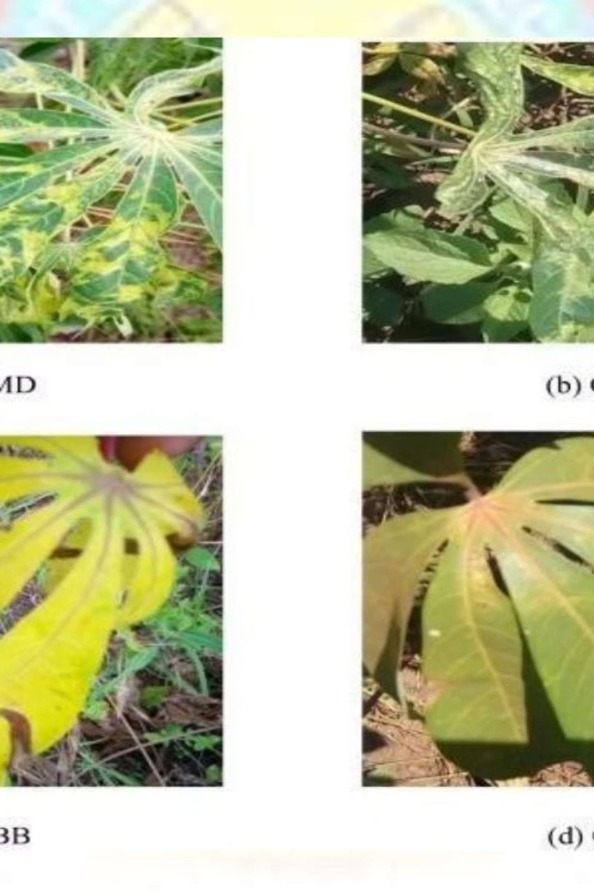
Introduction: Cassava Leaf Disease Detection
Cassava is a vital staple crop, especially in Sub-Saharan Africa, but its production is threatened by various leaf diseases. These diseases cause significant yield losses and impact food security.
Lightweight CNNs offer accessible tools for rapid diagnosis, supporting timely management decisions and improving crop yields.

Slide 3
Problem Statement & Objectives
Problem
Objectives
Traditional disease identification methods are slow and inaccessible. Existing CNN models are computationally intensive, unsuitable for mobile deployment. A lightweight, accurate, and efficient CNN framework is needed for multi-class cassava leaf disease detection.
Apply data augmentation for training set diversification.
Address class imbalance using class weighting strategies.
Develop a deep learning-based leaf image classification model.
Demonstrate custom model outperformance against standard models.

Slide 4
Significance of the Study
Revolutionizing Agriculture
Smart Farming
Advanced AI Techniques
Automating disease identification enables informed decisions, reducing excessive pesticide use and promoting sustainable practices.
Emphasizes Custom CNN and data augmentation, adapting pre-trained models for specialized tasks with limited datasets.
Accurate and prompt disease classification can significantly reduce crop losses and improve agricultural productivity.

Slide 5









Tools and Libraries
Python 3.4
Jupyter Notebook
Google Colab
Primary language for model building, data preprocessing, training, and evaluation.
Interactive environment for modular development and detailed analysis.
Cloud-based platform with free GPU/TPU access for faster model training.
TensorFlow
Keras
Matplotlib
Core framework for implementing the custom CNN image classification model.
High-level API for simplifying deep learning model creation and training.
Used for visualizing training/validation trends and generating confusion matrices.
NumPy
Pandas
Pillow (PIL)
Fundamental package for scientific computing, handling numerical operations.
Powerful library for data analysis and manipulation, especially for structured data.
Image processing library for manipulation, augmentation, and pre-processing.

Slide 6

Proposed Methodology: Overview
The methodology adopts a structured pipeline for cassava leaf disease identification, starting with dataset selection and progressing through preprocessing, partitioning, and model learning.
The dataset comprises five distinct classes: Cassava Mosaic Disease (CMD), Cassava Green Mottle (CGM), Cassava Brown Streak Disease (CBSD), Cassava Bacterial Blight (CBB), and Healthy leaves.

Slide 7
Data Preprocessing
Resizing & Normalization
Dataset Distribution (After SMOTE)
Images are resized to 32x32 pixels to reduce computational overhead. Pixel values are normalized to [0,1] for efficient training.
Class Name
After SMOTE
0 (CBB)
13,158
Class Imbalance
1 (CMD)
13,158
SMOTE (Synthetic Minority Over-sampling Technique) is used to balance the dataset, addressing the disproportionate representation of Cassava Mosaic Disease.
2 (CGM)
13,158
3 (Healthy)
13,158
4 (CBSD)
13,158
Total
65,790

Slide 8
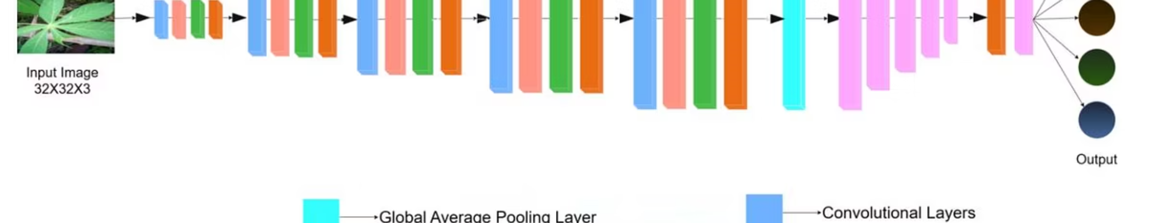
Model Design: CNN Architecture
The proposed CNN architecture extracts hierarchical spatial features, performs dimensionality reduction, and classifies cassava leaf diseases with high fidelity.
It includes convolutional blocks, batch normalization, max pooling, dropout layers, flattening, and fully connected layers to enhance representational capacity and curb overfitting.

Slide 9
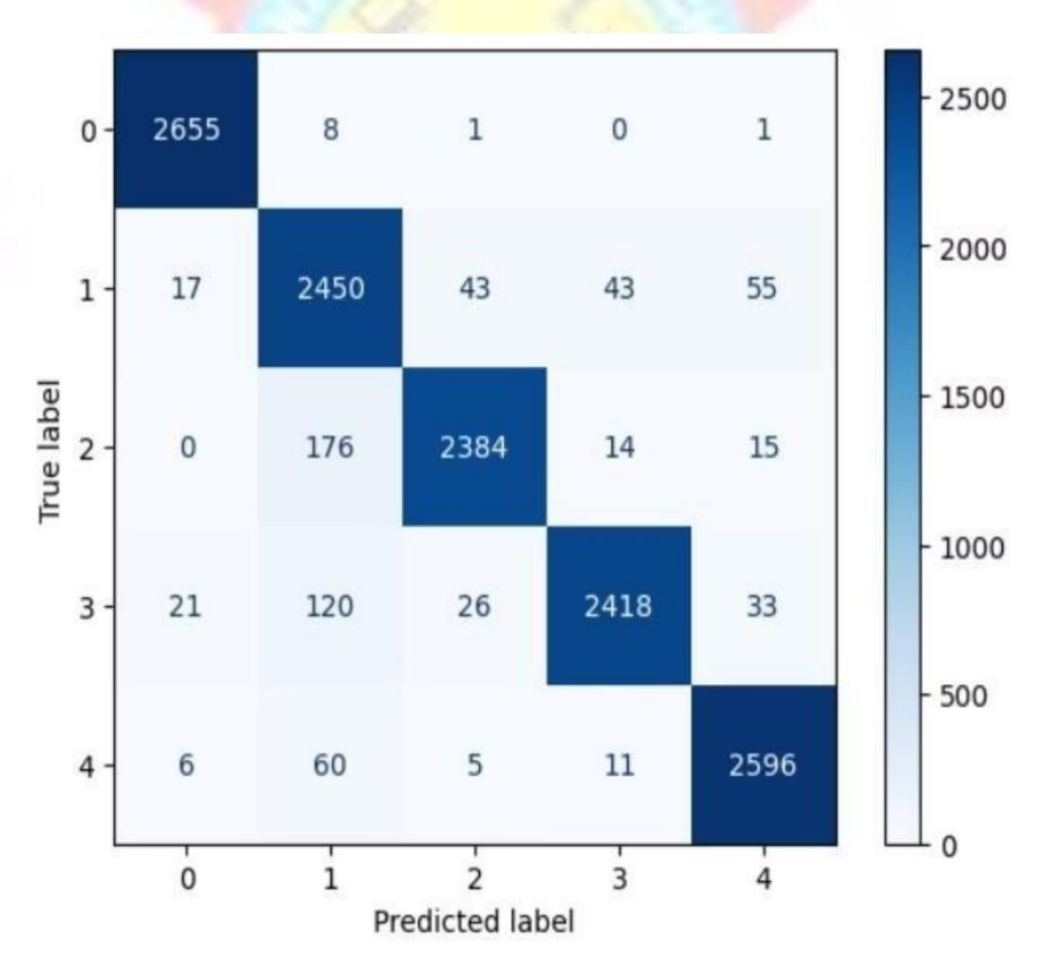
Performance Evaluation
Confusion Matrix
Classification Report
Class
Precision
Recall
F1-Score
Support
0 (CBB)
0.9837
0.9962
0.9899
2665
1 (CMD)
0.8706
0.9394
0.9037
2608
2 (CGM)
0.9695
0.9208
0.9445
2589
3 (Healthy)
0.9726
0.9236
0.9475
2618
4 (CBSD)
0.9615
0.9694
0.9654
2678
Accuracy
0.9502
0.9502
0.9502
–

Slide 10
Conclusion & Future Work
Impact on Agriculture
Future Work
The lightweight CNN framework achieves 95% validation accuracy, suitable for resource-constrained agricultural environments. It supports sustainable farming and global food security.
Expand dataset with diverse images and disease stages.
Add more disease categories, including rare ones.
Adapt framework for other crops like maize and rice.
Challenges
Integrate model into mobile/edge devices for real-time detection.
Dataset imbalance and data quality were primary challenges, requiring techniques like SMOTE and careful preprocessing.

